Slide 1
Software Design for Data Science
Style & Documentation
Melissa Winstanley
University of Washington
February 27, 2025

Slide 2

Style and documentation…
YAWN!

Slide 3

BUT! Everyone loves animals

Slide 4
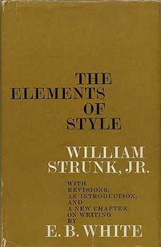
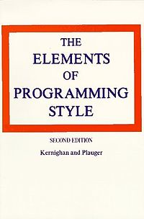


How to write vs how to write effectively
Notes:
AKA Strunk & White
1918 (Strunk), 1959
Doesn’t describe how to write in English
Describes how to write effectively in English
Writing is understandable and efficient
1974
Doesn’t describe how to write programs
Describes how to write efficient programs that can be read by computers and people
Why is it important that people can read your code?

Slide 5

SURF-ing!
Why is it important that people can read your code? (SURF)
Sustainable
New version of Python (4.X)
Understandable
Is it doing what you claim?
Reusable
Can it be incorporated into a larger project?
Fixable

Slide 6

Style
Ultimately, it doesn’t change how things work, just how approachable it is

Slide 7

Most important rule: consistency
With yourself, over time!
With existing code and others!

Slide 8

Many different styles…
PEP8 (most common)
“Python Enhancement Proposal #8”
Google Python Style Guide
“More complete” PEP8

Slide 9

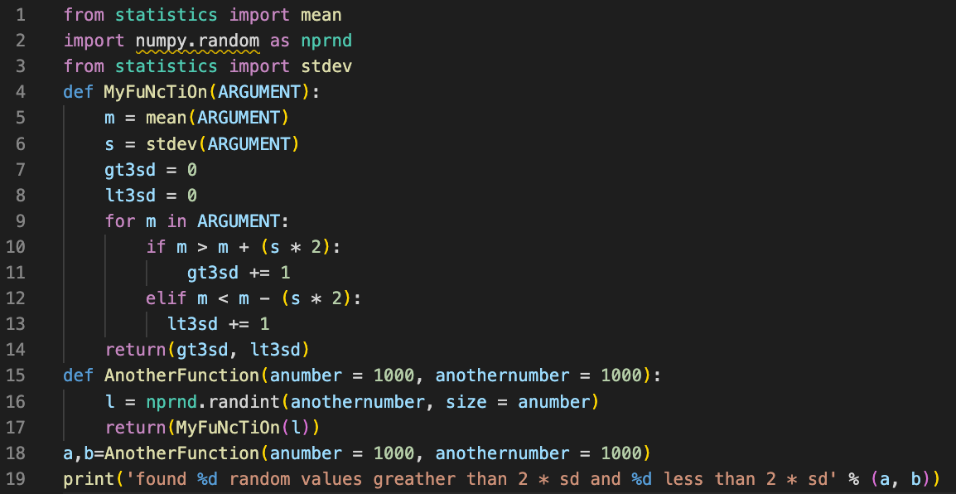
Use color! Use an editor!

Slide 10

Tools for style checking
Pylint
Extends from the lint tool for C
conda install pylint pylint filename.py pylint directory_name
Also
pycodestyle
flake8

Slide 11

Exercise Part 1: Get Set Up
Install pylint
conda install pylint
Clone the demo repository (linked from the syllabus)
git clone https://github.com/UWDATA515/style_documentation_example.git
Enter the repository directory
cd style_documentation_example
Run pylint
pylint style_demo.py
Don’t try to improve it yet!

Slide 12

The core pieces of style
Spacing/indentation
Line length
Imports
Code constructions
Naming

Slide 13

Spacing
Indentation is so important in Python!
Four spaces per indentation (not tabs!)
Line wrapping - let’s see!
Set your editor to convert tabs into spaces!

Slide 14

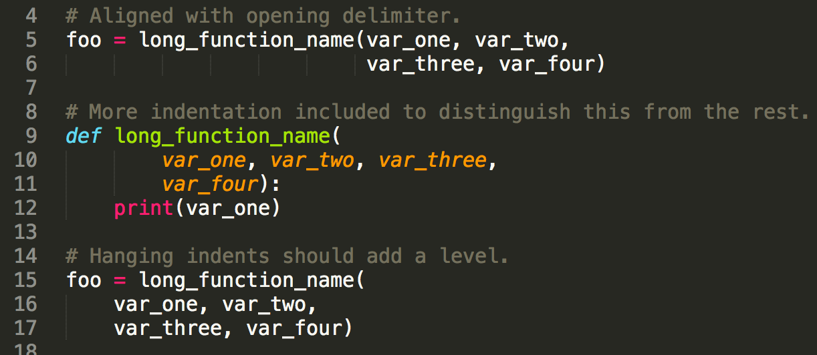
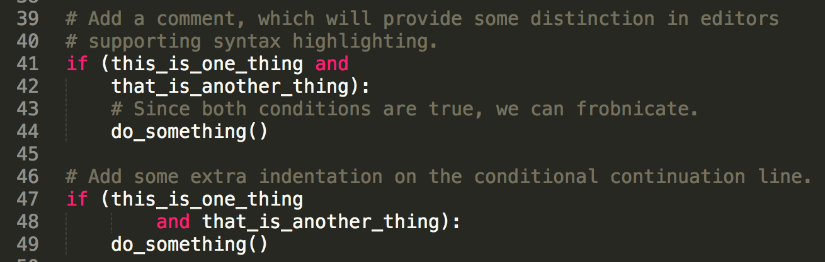
YES! indentation
✅

Slide 15

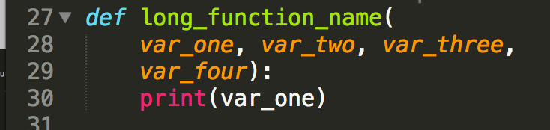
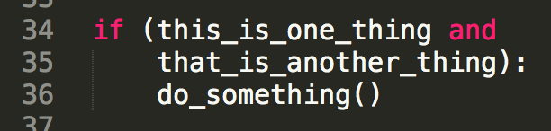
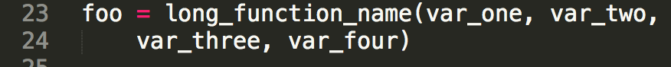
NO! Indentation
⛔

Slide 16

Line spacing
Two blank lines around top-level functions
Two blank lines around classes
One blank line between functions in a class
One blank line between logical groups in a function (sparingly)
Extra blank lines between groups of groups of related functions (why are they in the same file?)

Slide 17


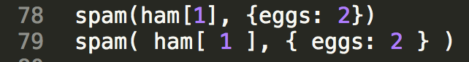
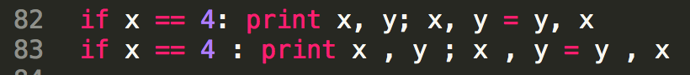
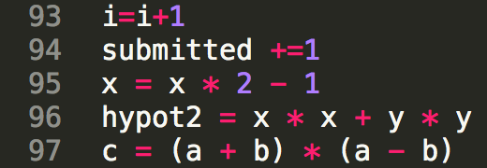
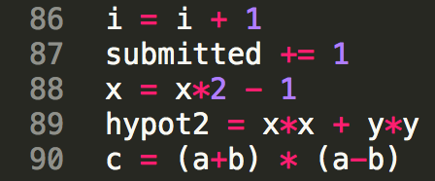
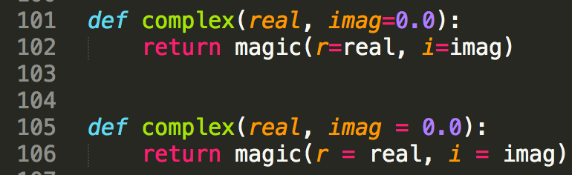
Whitespace
NO YES
Brackets & braces
: ; ,
Mathy stuff
Function
parameters
Trailing spaces at the end of a line

Slide 18

Line length
Coding lines? Keep it to 79 characters
Most editors can show you the line position
Comments & doc strings?
72 characters
Why? My monitor is big!
Open two files side by side? History?
Some teams choose to use a different max
Python core library is 79/72

Slide 19

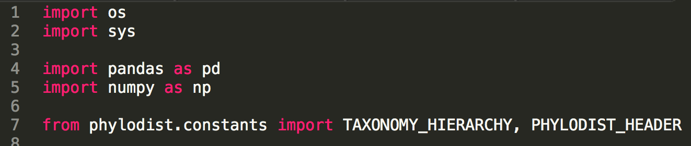
Imports
At the top of the file!
(after any comments)
First: standard library imports
Blank line
Second: third party imports
Blank line
Last: local imports

Slide 20

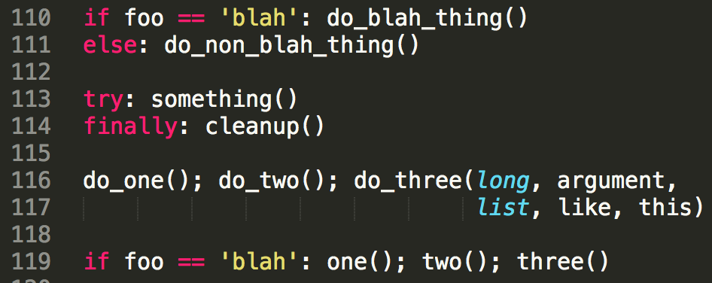
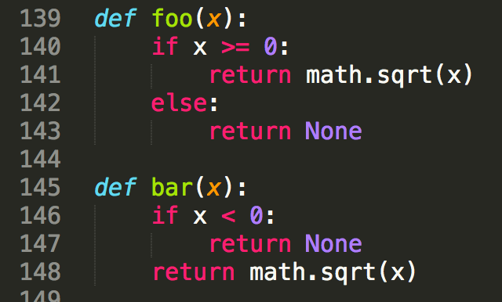
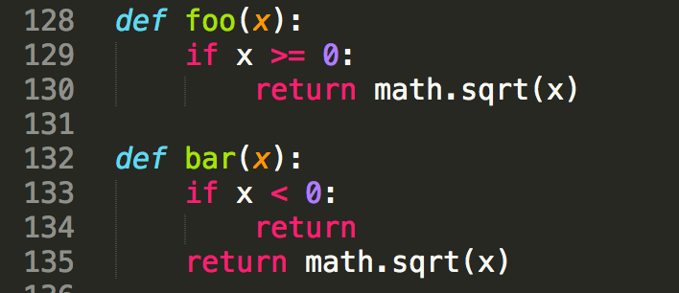
Code constructions
Avoid compound statements!
Always include returns!

Slide 21

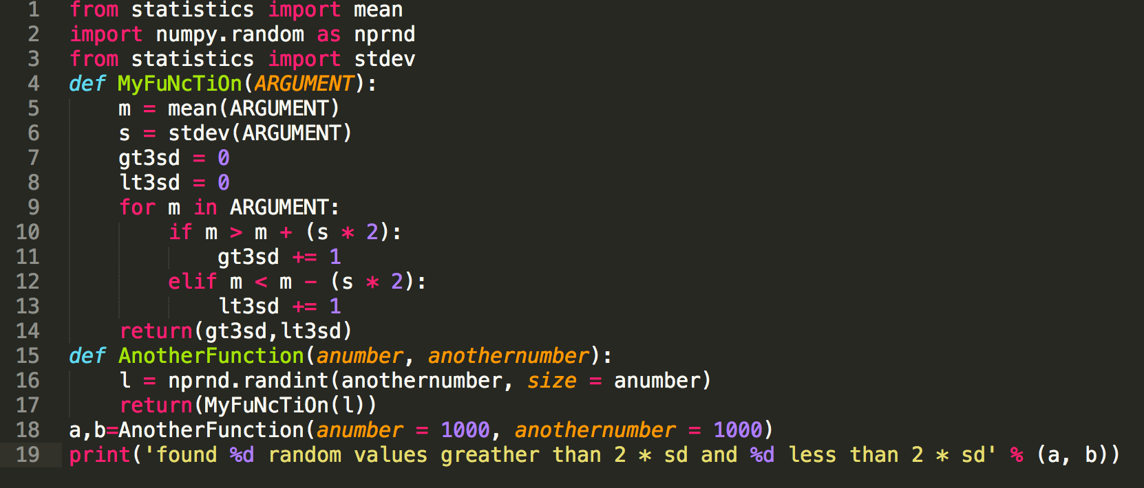
Naming
Choose variable names that won’t be confused.
How you name functions, classes, and variables can have a huge impact on readability

Slide 22
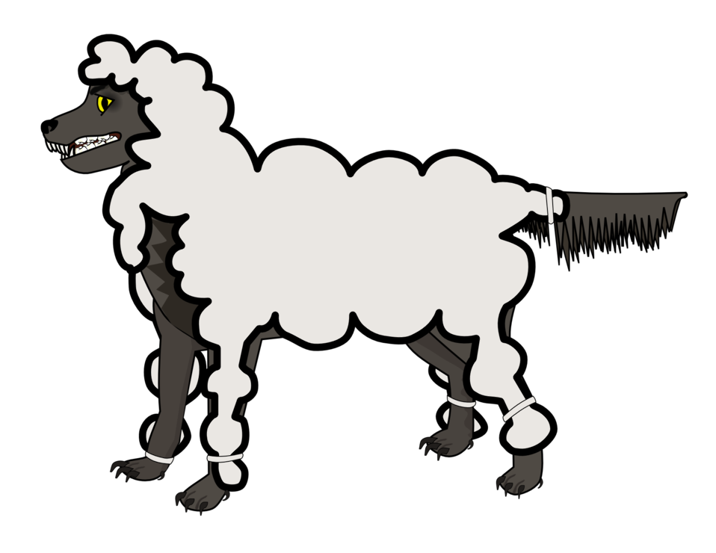
Naming
Avoid the following variable names:
Lower case L (l)
Upper case O (O)
Upper case I (I)
These are unacceptable, terrible, and awful. Why?
Can be confused with 1 and 0 in some fonts
Can be confused with each other (i.e. I and l)

Slide 23


Naming
Functions
Where units matter, append them…
Variable names also
Things go wrong…
Mars Climate Orbiter
… on September 23, 1999, communication with the spacecraft was lost as the spacecraft went into orbital insertion, due to ground-based computer software which produced output in non-SI units of pound-seconds (lbf×s) instead of the metric units of newton-seconds (N×s) specified in the contract between NASA and Lockheed.
- Wikipedia
655.2 million dollar mistake!

Slide 24

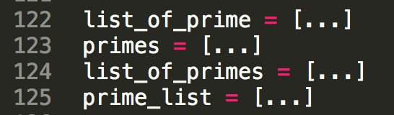
Naming
When naming functions and variables…
Be consistent about pluralization / type Ids
Which do you prefer and why?
Given your choice for the above, what would I name a variable that contained a collection of times? Users?

Slide 25

Naming
Conventions
Module names should be short, lowercase
Underscores are OK if it helps with readability
Package names should be short, lowercase
Underscores are frowned upon and people will speak disparagingly behind your back if you use them

Slide 26

Naming
Functions
Some prefixes that can be used to clarify
compute
get/set
find
is/has/can
Use complement names for complement functions
get/set, add/remove, first/last
Reserve for functions that compute something sophisticated, e.g. not average
What kind of return value would you expect from a function with this kind of prefix?

Slide 27
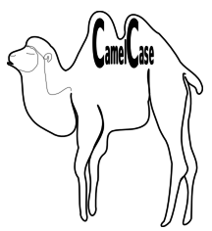
Naming
Class names should be in CapWords
SoNamedBecauseItUsesCapsForFirstLetterInEachWord
Also known as CamelCase
Notice no underscore!
Much hate on the internet for Camel_Case

Slide 28

Naming
What naming convention should I use for exceptions?
WHY?

Slide 29

Naming
Functions
Lowercase, with words separated by underscores as necessary to improve readability
mixedCase is permitted if that is the prevailing style (some legacy pieces of Python used this style)
Be consistent

Slide 30
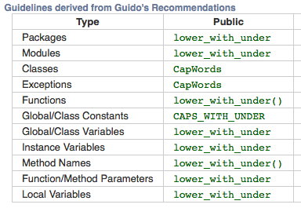

Naming
Naming conventions

Slide 31

Exercise Part 2: Style
Run pylint on the style demo file:
pylint style_demo.py
Use an editor to get it to at least 8/10!
In addition, try to improve the following:
Naming of functions and variables
Pull common constants out into CONSTANTS
Ignore documentation-related issues for now.

Slide 32
Most important rule: consistency

Slide 33
Documentation

Slide 34
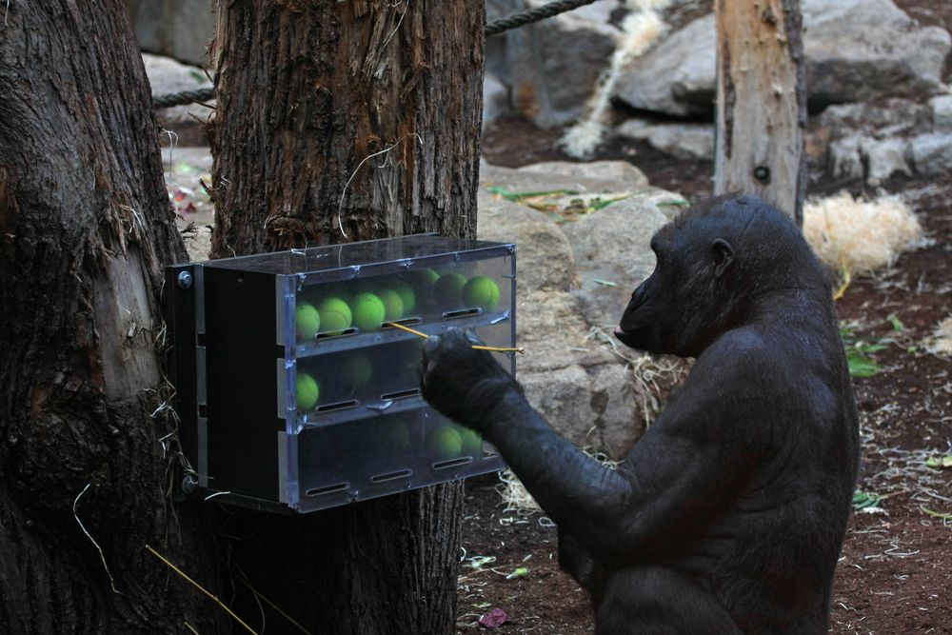

Documentation
Documentation is for two types of people
Code readers Users
README.md
Code comments

Slide 35

Documentation: README
What kind of stuff goes in a repositories README.md?
https://github.com/kallisons/NOAH_LSM_Mussel_v2.0

Slide 36

Documentation: Comments
In Python:
# comment here
In shell scripting/bash:
# comment here
Always followed by a space before the rest of the comment.

Slide 37
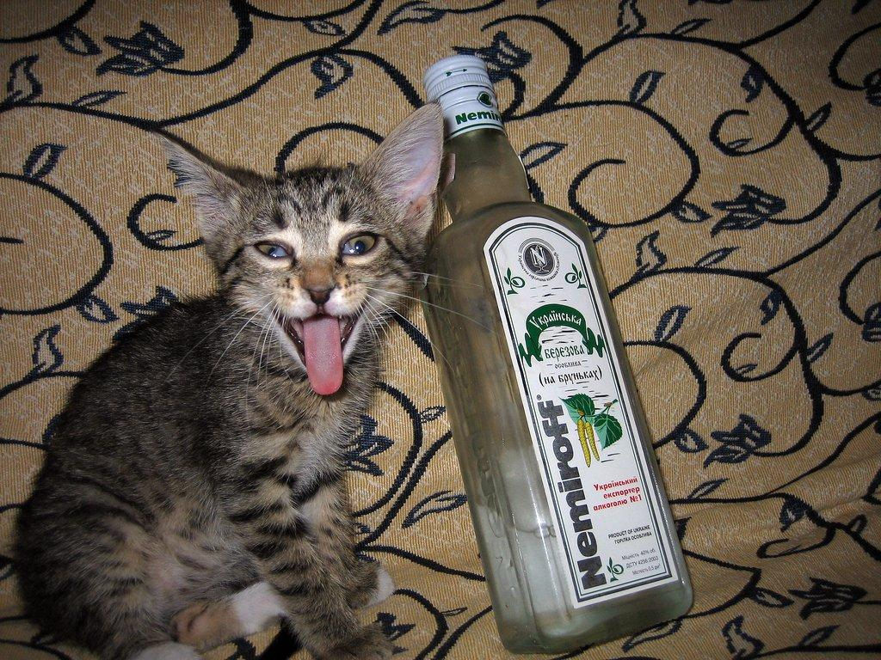
Documentation: Comments
Some examples of bad comments (from the ‘net)
# For the brave souls who get this far: You are the chosen ones,
# the valiant knights of programming who toil away, without rest,
# fixing our most awful code. To you, true saviors, kings of men,
# I say this: never gonna give you up, never gonna let you down,
# never gonna run around and desert you. Never gonna make you cry,
# never gonna say goodbye. Never gonna tell a lie and hurt you.
# drunk, fix later
Don’t Rick Roll your readers!
Uhm… Sigh.

Slide 38

Documentation: Comments
# Dear maintainer:
#
# Once you are done trying to 'optimize' this routine,
# and have realized what a terrible mistake that was,
# please increment the following counter as a warning
# to the next guy:
#
# total_hours_wasted_here = 42
true = false
# Happy debugging suckers
http://stackoverflow.com/questions/184618/what-is-the-best-comment-in-source-code-you-have-ever-encountered
Funny is funny, but don’t troll.
And what was the issue the writer encountered?
At least it is logical?

Slide 39

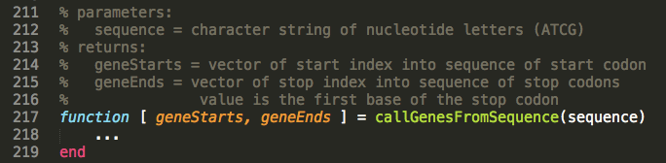
Documentation: Comments
Good comments…
…make the code easy to read
…are written in English
…discuss the function parameters and results

Slide 40
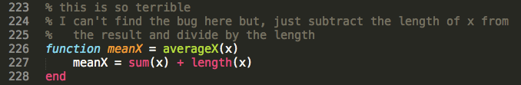

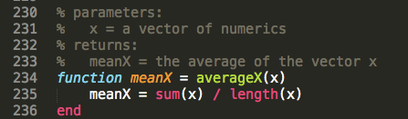
Documentation: Comments
Don’t comment bad code, rewrite it!
Then comment it

Slide 41

Documentation: Inline Comments
Comments on the same line as code
Use sparingly
Make sure it’s actually useful!
Make sure the line isn’t too long
Make sure the code is still readable

Slide 42
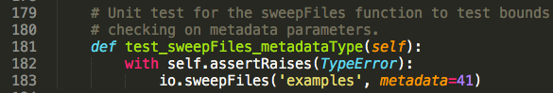
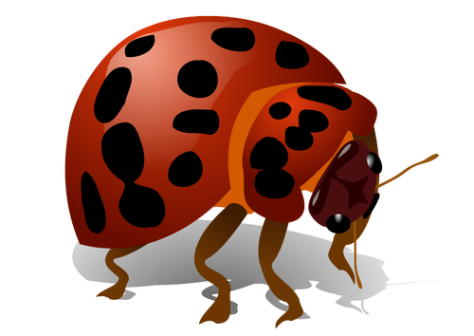
Documentation: Comments in Code
Wrong comments are bugs
Don’t forget to update the comments!

Slide 43

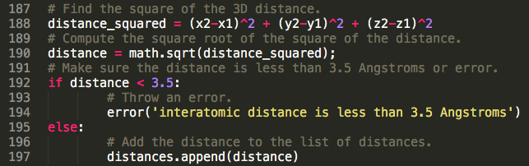
Documentation: Comments in Code
Don’t insult the reader!
If they’re reading your code, they aren’t that dumb
Corollary:
Don’t comment every line

Slide 44
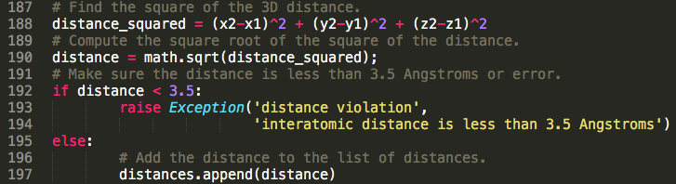

Documentation: Comments in Code
Example: what’s not great about this, other than too many comments?
What if I want to change the cutoff distance? There are 3 places to change it!

Slide 45
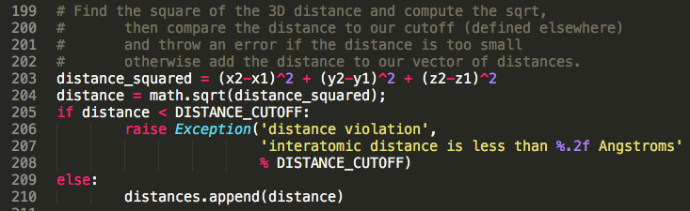

Documentation: Comments in Code
Note: English! Full sentences!
Better
Obvious constant
Comments are consolidated and don’t mention the cutoff

Slide 46
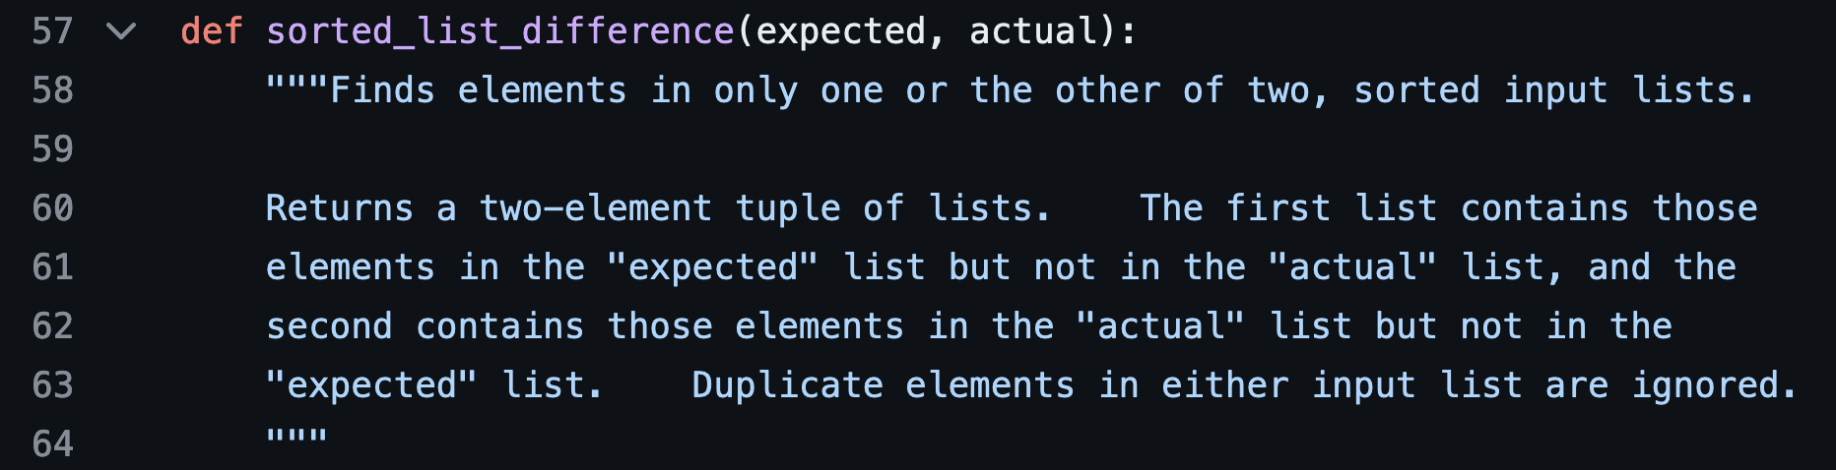

Documentation: Docstrings
When you provide a plain old string as the FIRST thing in a (function or class or module)
Use triple quotes

Slide 47

Documentation: Docstrings
What are they for?
Documenting things users will need to know how to use
Functions
Modules
Classes

Slide 48

Documentation: Docstrings
Why?
They can be processed by the docutils package into HTML, LaTeX, etc. for high quality code documentation (that makes you look smart).
Try it out when you’ve written some docstings:
python -m pydoc my.module

Slide 49
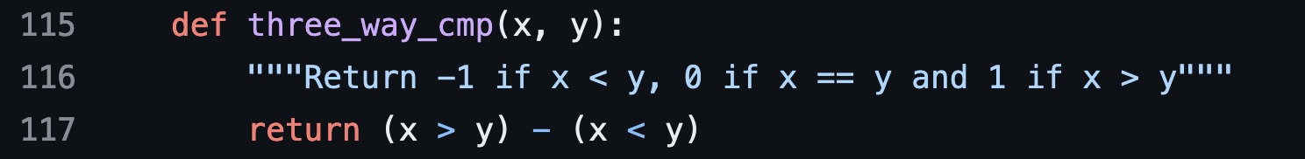

Documentation: Docstrings
One line for simple stuff

Slide 50

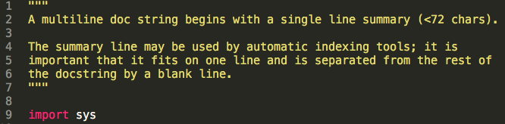
Documentation: Docstrings
Multiline for more complicated things

Slide 51
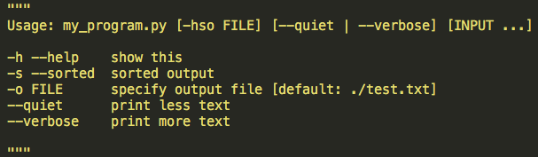

Documentation: Docstrings
For scripts intended to be called from the command line, the docstring at the top of the file should be a usage message for the script.

Slide 52

Documentation: Docstrings
For modules, list the classes, exceptions and functions (and any other objects) that are exported by the module, with a one-line summary of each.
https://github.com/numpy/numpy/blob/master/numpy/__init__.py

Slide 53

Documentation: Docstrings
For functions, include all of the good interface specification stuff we’ve talked about:
Name
Arguments
Return values
Side effects
Edge cases
Exceptions
Examples
https://github.com/scikit-learn/scikit-learn/blob/main/sklearn/cluster/_dbscan.py

Slide 54


Exercise Part 3: Documentation
Run pylint on the style demo file:
pylint style_demo.py
Use an editor to get it to 10/10!

Slide 55
Lastly: Ignoring recommendations
Sometimes you disagree with a PEP8 recommendation
Or you made a very conscious choice to do it differently
You can tell pylint to ignore the issue with a comment on the line before:
# pylint: disable=consider-using-f-string
NOT OFTEN!
We WILL deduct points on your project if you use this without a good reason

Slide 56
Exercise 4: Adding Style to Continuous Integration
You must add linting to your continuous integration for your project:
https://github.com/UWDATA515/ci_example/blob/536d2f84c2a18dd3d82647cfb4d6dfd38ab52068/.github/workflows/build_test.yml#L95-L100
However, it probably won’t pass the first time.
Take this time to fix style and add documentation to your project
Then add linting to your continuous integration GitHub Actions Workflow

